Slide 1
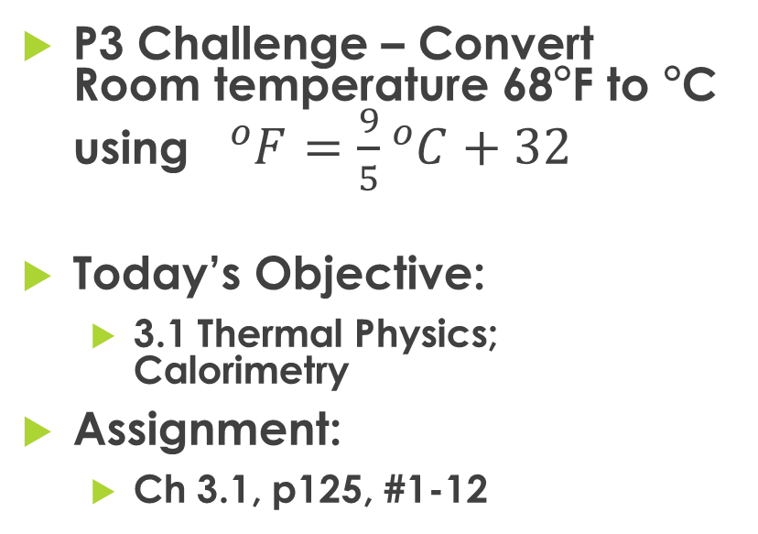
Physics 2 – Mar 5, 2019
P3 Challenge – Convert Room temperature 68F to C using ${}_{ }^{o}{F=\frac{9}{5}{}_{ }^{o}{C+32}}$
Today’s Objective:
  3.1 Thermal Physics; Calorimetry
Assignment:
  Ch 3.1, p125, #1-12
Agenda
  Kinetic theory of matter
  Temperature
  Measuring temperature – thermal equilibrium
  Heat
  Measuring heat
  Phase changes
  Heating graph for water
  Calorimetry

Slide 2
States of Matter – atomic description
Three states of matter, Solid, liquid and gas.
Solids are a rigid ordered matrix of particles. Particles wiggle.
Liquid particles remain in contact but can move around each other. Liquids can flow. Individual particles may leave by evaporation.
Gas particles are widely spaced with no inter-particle forces. Particles move in random straight-line motion through the available space. They undergo elastic collisions with each other and the container.
https://phet.colorado.edu/sims/html/states-of-matter/latest/states-of-matter_en.html

Slide 3
Kinetic Theory of Matter
The Kinetic Theory of Matter states that matter is composed of a large number of small particles are in constant random motion.
For any motion there is a corresponding kinetic energy.
For our purposes here, those small particles will be either atoms or molecules. Perhaps electrons, but no smaller.
(We’ll do particle physics in Year 2 and look at particles more closely.)

Slide 4
Temperature (Kelvin)
Temperature (in Kelvin) is directly proportional to the average kinetic energy of the particles in motion.
If there is no particle motion, there is no temperature.
0 K is absolute zero.
Absolute zero has never been observed. The current lowest temperature recorded is 0.000 000 001K.
  In 2003, MIT recorded the temperature of a gas sample at 0.5 nK.
Highest temperature is estimated to be about 10³² K, within the Big Bang.
Above 1.42 x 10³³ K, the Planck temperature, conventional physics fails.

Slide 5
Measuring Temperature
Measuring temperature requires
  A) a standard: boiling and freezing points of water at 1 atm OR absolute zero.
  B) a unit: Kelvin (must use with mult/div) or Celsius (may use if only using differences)
  C) a thermometer, that
    uses a substance that has a linear coefficient of expansion with thermal energy
    is calibrated
    is in thermal equilibrium with the item whose temperature you wish to measure.

Slide 6
Temperature Scales
Three common temperature scales:
 | ◦F | ◦C | K
B.P of water | 212◦F | 100◦C | 373.15 K
Body Temp | 98.6◦F | 37.0◦C | 310.15 K
Room Temp | 68◦F | 20◦C | 293 K
M.P. of water | 32◦F | 0◦C | 273.15 K
Absolute Zero | – 459.7◦F | – 273.15◦C | 0 K

Slide 7
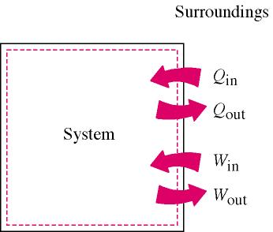
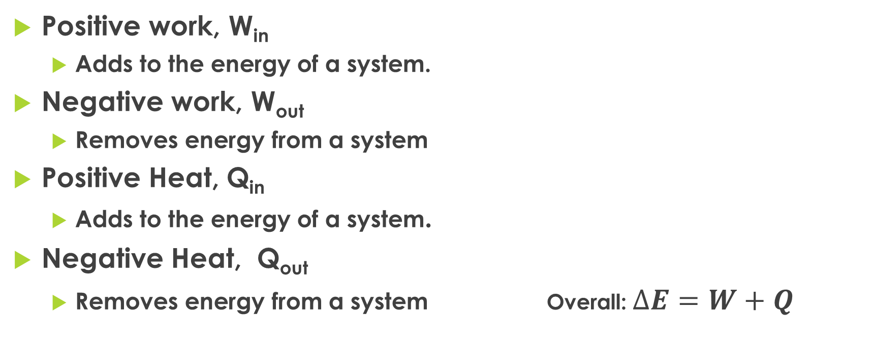
Change in energy for a system
Positive work, W_{in}
  Adds to the energy of a system.
Negative work, W_{out}
  Removes energy from a system
Positive Heat, Q_{in}
  Adds to the energy of a system.
Negative Heat, Q_{out}
  Removes energy from a system Overall: $∆E=W+Q$

Slide 8
Exothermic process
An exothermic process is one that releases energy.
The system will become colder.
Energy is a product.
Surroundings gets hotter. (explosion)
ΔE = E_{final} – E_{initial} is negative
Energy
Initial state
Final state
E

Slide 9
Endothermic process
An endothermic process is one that absorbs energy.
You must heat an endothermic process to make it occur.
Energy is a reactant.
Surroundings gets colder.
ΔE = E_{final} – E_{initial} is positive
Energy
Initial state
E
Final state

Slide 10
Measuring heat
Heat is the transfer of thermal energy from one object to another, or between a system and its environment.
Heat always flows from a high temperature to a low temperature object, until they come into thermal equilibrium and have the same temperature.
Every substance absorbs or transmits heat in a unique way that can be quantified as the heat capacity of the substance.

Slide 11
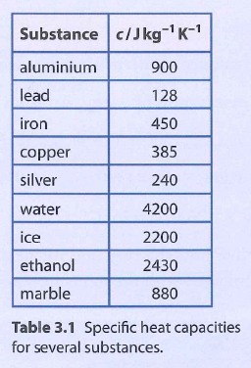
Heat Capacity
Heat capacity has the symbol c, and the units of J/kgK
  Other units for c may be J/gC, or cal/gC
  Use 4184 J/kgK for water for more sigfigs!

Slide 12
Change in Temperature
For any change in temperature from T_{initial} to T_{final},
For a temperature increase, ΔT is positive.
For a temperature decrease, ΔT is negative.

Slide 13
Calculating Heat, q
Heat exchanged during the temperature change is given by:
Where q is the heat, m is the mass of the substance, c is the specific heat capacity of the substance and ΔT is the temperature change.

Slide 14
Heat
Problem type 1: Temperature change is given in the problem either as final and initial temperatures or directly as a temperature change. Two of the other three variables are also defined.
  Note: if you know the identity of the substance you can look up its c in a table

Slide 15
Heat
Problem type 1: Ex: How much heat is needed to raise 2.50 g of ethanol from 25 ◦C to body temperature of 37 ◦C? (Specific heat of ethanol is 2.42 J/g ◦C )
q =
m =
c =
ΔT =
?
2.50 g
2.42 J/g ◦C
37 ◦C – 25 ◦C = 12 ◦C
q = mc ΔT
q = (2.50 g) (2.42 J/g ◦C)(12 ◦C)
q = 72.6 J

Slide 16
Calorimetry
Problem type 2: Either the final or initial temperatures is asked for. The mass, heat and specific heat capacity must be given.
  Strategy: use q=mc ΔT to solve for ΔT. Then use ΔT = T_{f} –T_{i} to solve for the unknown temperature.

Slide 17
Calorimetry
Ex: If 45.0 J of energy is added to 15.8 g of water at 23.5 ◦C, what is the final temperature of the water?
q =
m =
c =
ΔT =
45.0 J
15.8 g
4.184 J/g ◦C
?
q = mc ΔT
(45.0 J) = (15.8 g) (4.184 J/g ◦C) ΔT
ΔT =0.681◦C
0.681◦C = T_{f} – 23.5 ◦C
T_{f} = 24.2 ◦C

Slide 18
Phase Changes
There are six phase changes you should be aware of. 4 are very common, 2 are rare and are not in the IB book.
Solid → Liquid = melting (at m.p)
Liquid → Solid = freezing (at m.p)
Liquid → Gas = evaporation (at any temp) or boiling (at b.p)
Gas → Liquid = condensation (at b.p)
Solid → Gas = sublimation - rare
Gas → Solid = deposition - rare

Slide 19
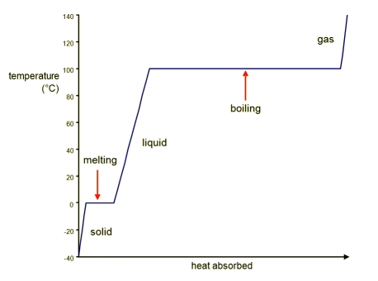
Heating Curve
This is the heating curve for water.
The first slope is the q = mcT for ice up to 0C.
At 0C it melts at constant T.
The second slope is the q = mcT for water up to 100C.
At 100C, it boils at constant T.
The third slope is the q = mcT for steam from 100C up.

Slide 20
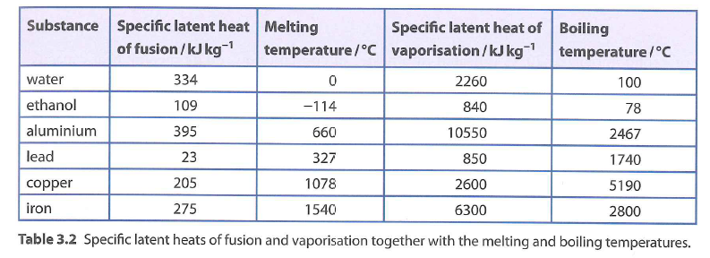
Heat during Phase changes
For the constant temperature phase changes, Q = mL
Where L is the specific latent heat of fusion for melting and freezing and
Or where L is the specific latent heat of vaporization for boiling and condensation.
The unit for L is J/kg or kJ/kg or J/g
Note the similarity between this equation and Q= mcT.

Slide 21
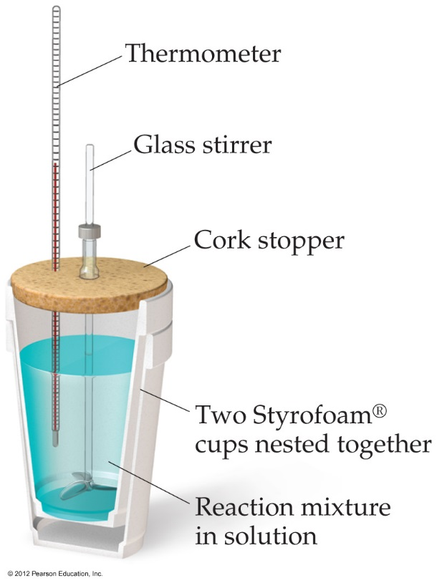
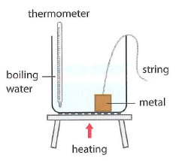
Calorimetry (method of mixtures)
Calorimetry is the measurement of heat.
In general, with any kind of calorimetry, there is some hot substance giving off heat and something else picking up that heat.
The amount of heat lost by the hot object = amount of heat gained by the cold object.
Either |Q_{c}| = |Q_{H}| or Q_{c}= - Q_{H}
Or to say it another way, the energy of the total system is conserved. Q_{c}+ Q_{H} =0
water

Slide 22
Calorimetry problem
A 525 g lead ball at a temperature of 100.0☑C is placed in a 25.0 g aluminum calorimeter containing 587.6 g of water at 17.5°C. Find the equilibrium temperature of the system.

Slide 23
Exit Slip - Assignment
Exit Slip- 235 J of heat is added to a 16.5 g sample of iron initially at 23.0C. What is the final temperature of the sample? (c = 450 J/kg K)
What’s Due? (Pending assignments to complete.)
  Ch 3.1, p125, #1-12 Due Tuesday
What’s Next? (How to prepare for the next day)
  Read 3.1 p116- 124 about Thermal Energy

